Slide 1
Project presentation on :- CUSTOMER RETENTION ANALYSIS
Submitted by :
ABHISHEK NIPANE

Slide 2
Table Of Contents :-
1. Introduction
1.1 What is customer retention?
1.2 Conceptual Background of the Domain Problem
2. 5 reasons why retention is the foundation of customer growth
3. Data analysis
4. Conclusion
5. Limitations of this work and Scope for Future Work
6. Acknowledgement

Slide 3
INTRODUCTION
What is customer retention?
Simply put, customer retention rate is the ability of a company to retain its customers over a given period of time.
There are a number of actions and activities certain companies take to reduce churn and increase customer retention.
Focusing on customer retention is important because it not only looks at how good a company is at acquiring new customers but also how good they are at keeping those customers. While you may have the best acquisition process in the business, if your retention is terrible then it’s all worthless.

Slide 4
Conceptual Background of the Domain Problem
Customer satisfaction has emerged as one of the most important factors that guarantee the success of online store; it has been posited as a key stimulant of purchase, repurchase intentions and customer loyalty.
A comprehensive review of the literature, theories and models have been carried out to propose the models for customer activation and customer retention.

Slide 5
5 reasons why retention is the foundation of customer acquisition and growth
1. Improve ROI
2. Convert more sales
3. Spend less on TOFU marketing
4. Increase customer LTV
5. Earn more referrals

Slide 6
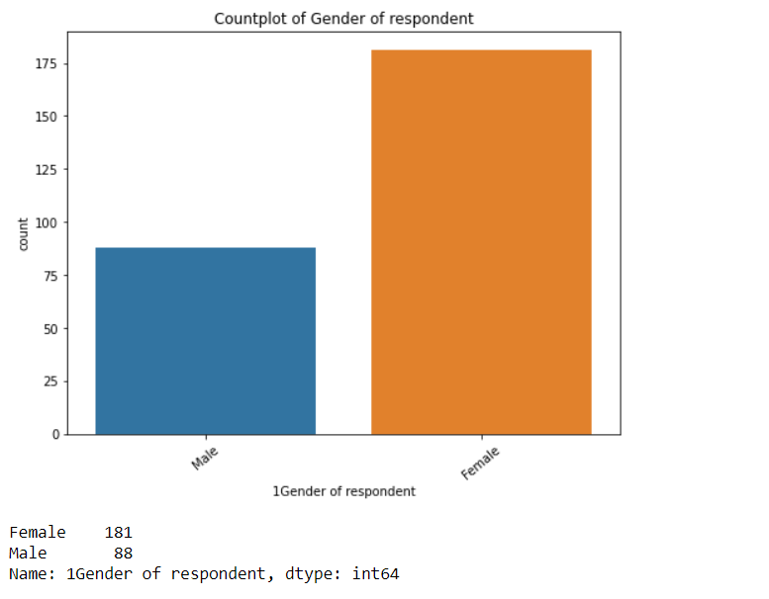
Data analysis
Observation:
Majority, 181 of the customers are Female whereas Male are 88.

Slide 7
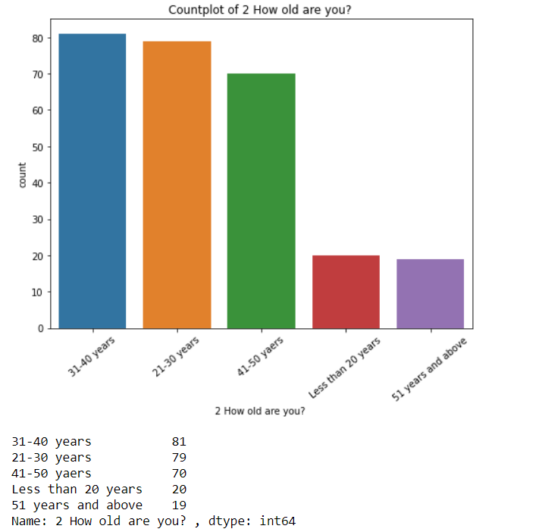
Observation:
Majority, 81 of the customers are from age group 31-40 years.

Slide 8
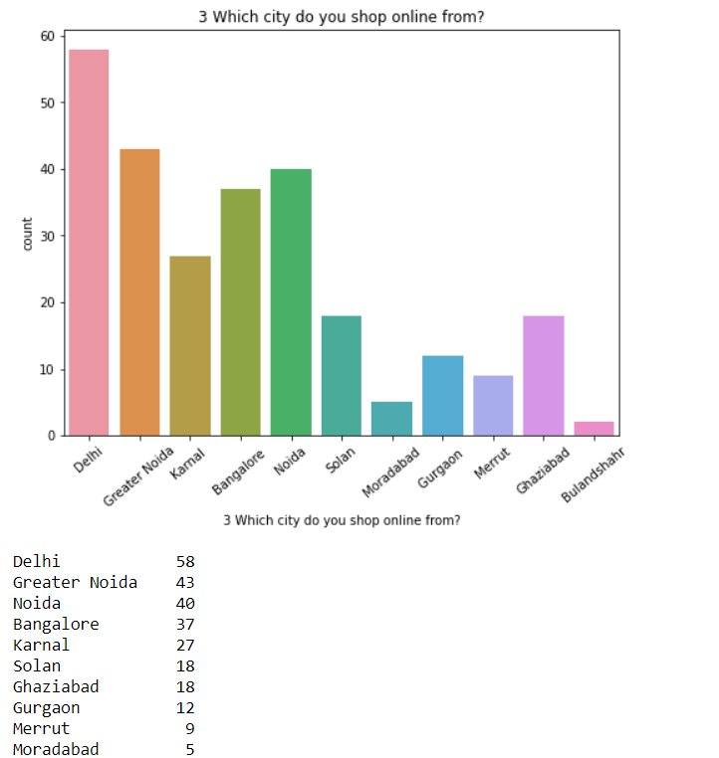
Observation:
Majority, 58 of the customers placed the order from Delhi city.

Slide 9
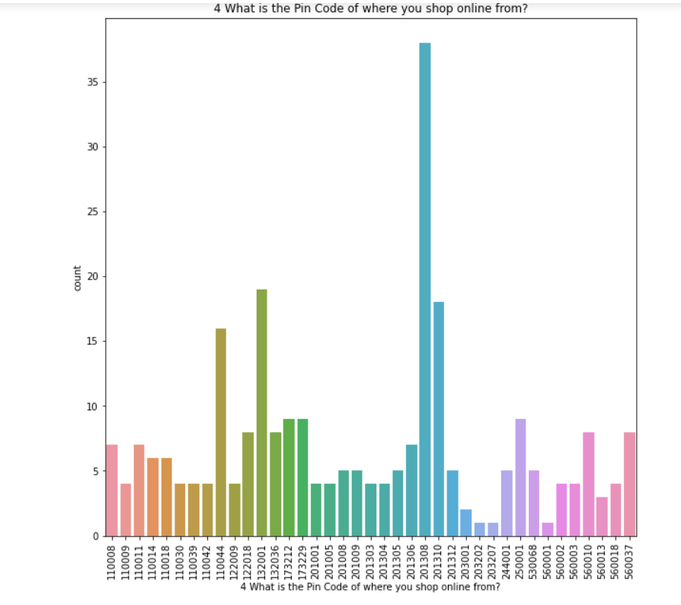
Observation:
Majority, 38 of the customers placed an order from the pin code 201308.

Slide 10
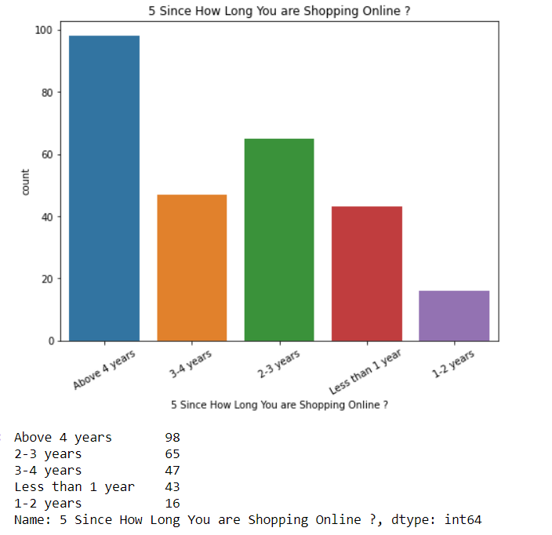
Observation:
Majority, 98 customers are shopping since above 4 years.

Slide 11
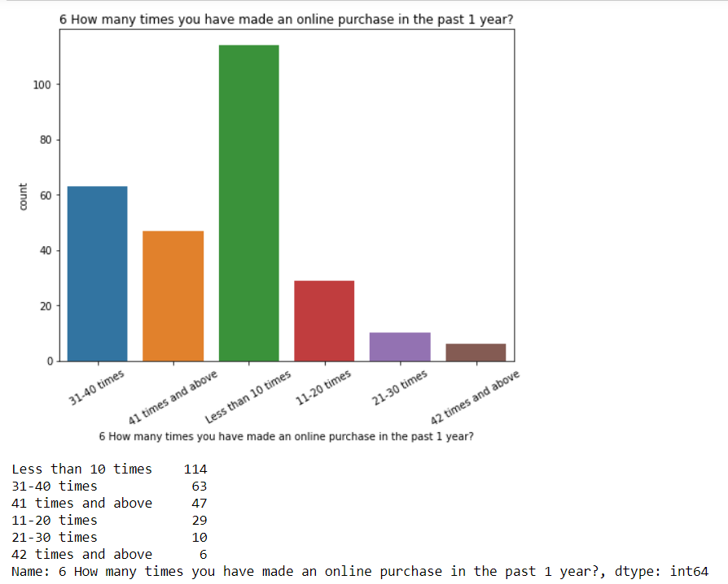
Observation:
Majority 114 of the customers have made less than 10 times online purchase in past 1 year

Slide 12
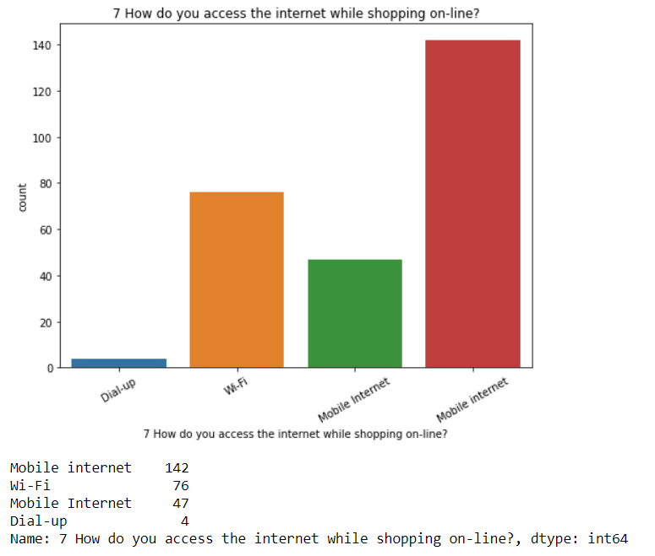
Observation:
Majority, 189 customers use Mobile internet while shopping online.

Slide 13
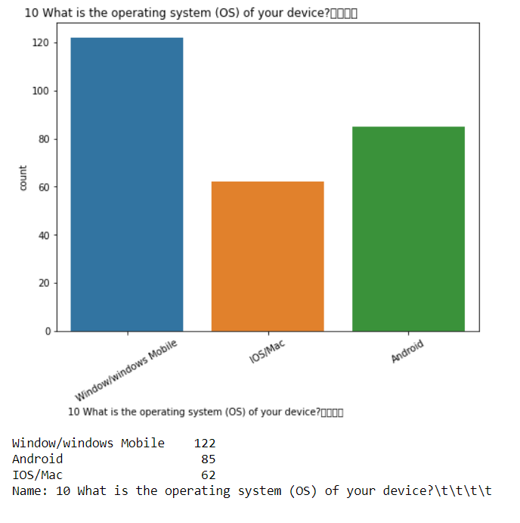
Observation:
Majority, 122 customers device operating system is Window/windows mobile

Slide 14
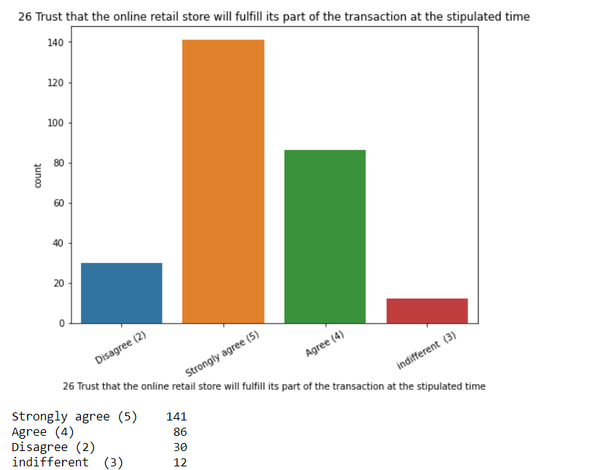
Observation:
Majority, 141 customers Strongly agree to Trust that the online retail store will fulfill its part of the transaction at the stipulated time

Slide 15
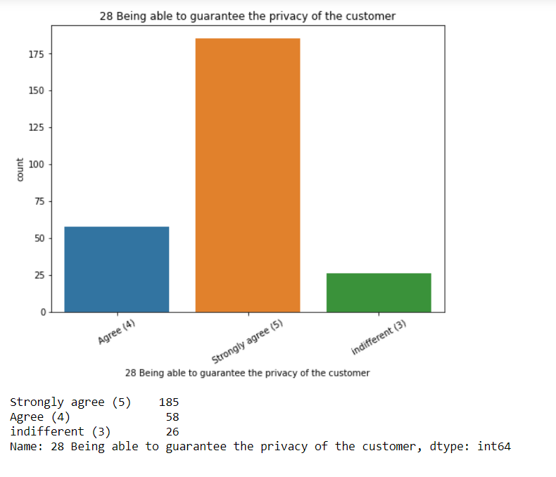
Observation:
Majority, 185 customers Strongly agree to Being able to guarantee the privacy of the customer

Slide 16
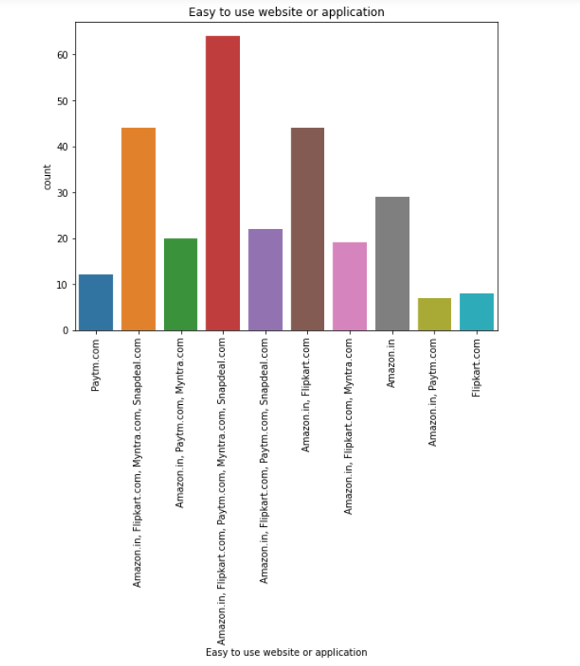
Observation:
Majority, 64 customers agree that Amazon.in, Flipkart.com, Paytm.com, Myntra.com, Snapdeal.com are Easy to use website or application

Slide 17
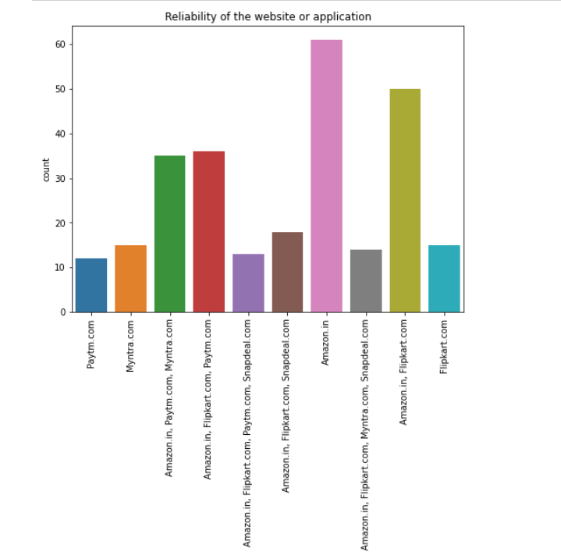
Observation:
Majority, 61 customers agree that Amazon.in Reliability of the website or application

Slide 18
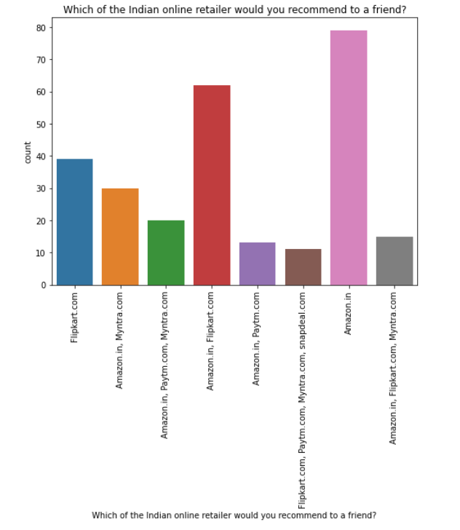
Observation:
Majority, 79 customers agree to Amazon.in to recommend to a friend

Slide 19
Conclusion
Retention analysis is an integral part of your customer retention and marketing strategies. By taking full advantage of the data you collect by tracking customer behaviour, requesting feedback, and studying important metrics, you can decrease the churn rate, improve customer satisfaction, and boost your revenue.

Slide 20
Limitations of this work and Scope for Future Work
We are able to properly analyse the valuable feedback of the customers but given, the dataset was very small as it may result in bias understanding. If we are able to increase the feedbacks from more customers all over it would provide a great understanding of the strategies, we will have to use to improve customer retention.

